Slide 1
Prediction of Car Mileage
Nikhil Sojan
Pranav Ashish Menon
Darshana Suresh
Saai Lakshmi

Slide 2

Objective
To predict the miles per gallon for a particular car model depending on the machine’s features.

Slide 3
DATASET FEATURES
Attribute Information: 1. mpg: continuous 2. cylinders: multi-valued discrete 3. displacement: continuous 4. horsepower: continuous 5. weight: continuous 6. acceleration: continuous 7. model year: multi-valued discrete 8. origin: multi-valued discrete 9. car name: string (unique for each instance)

Slide 4
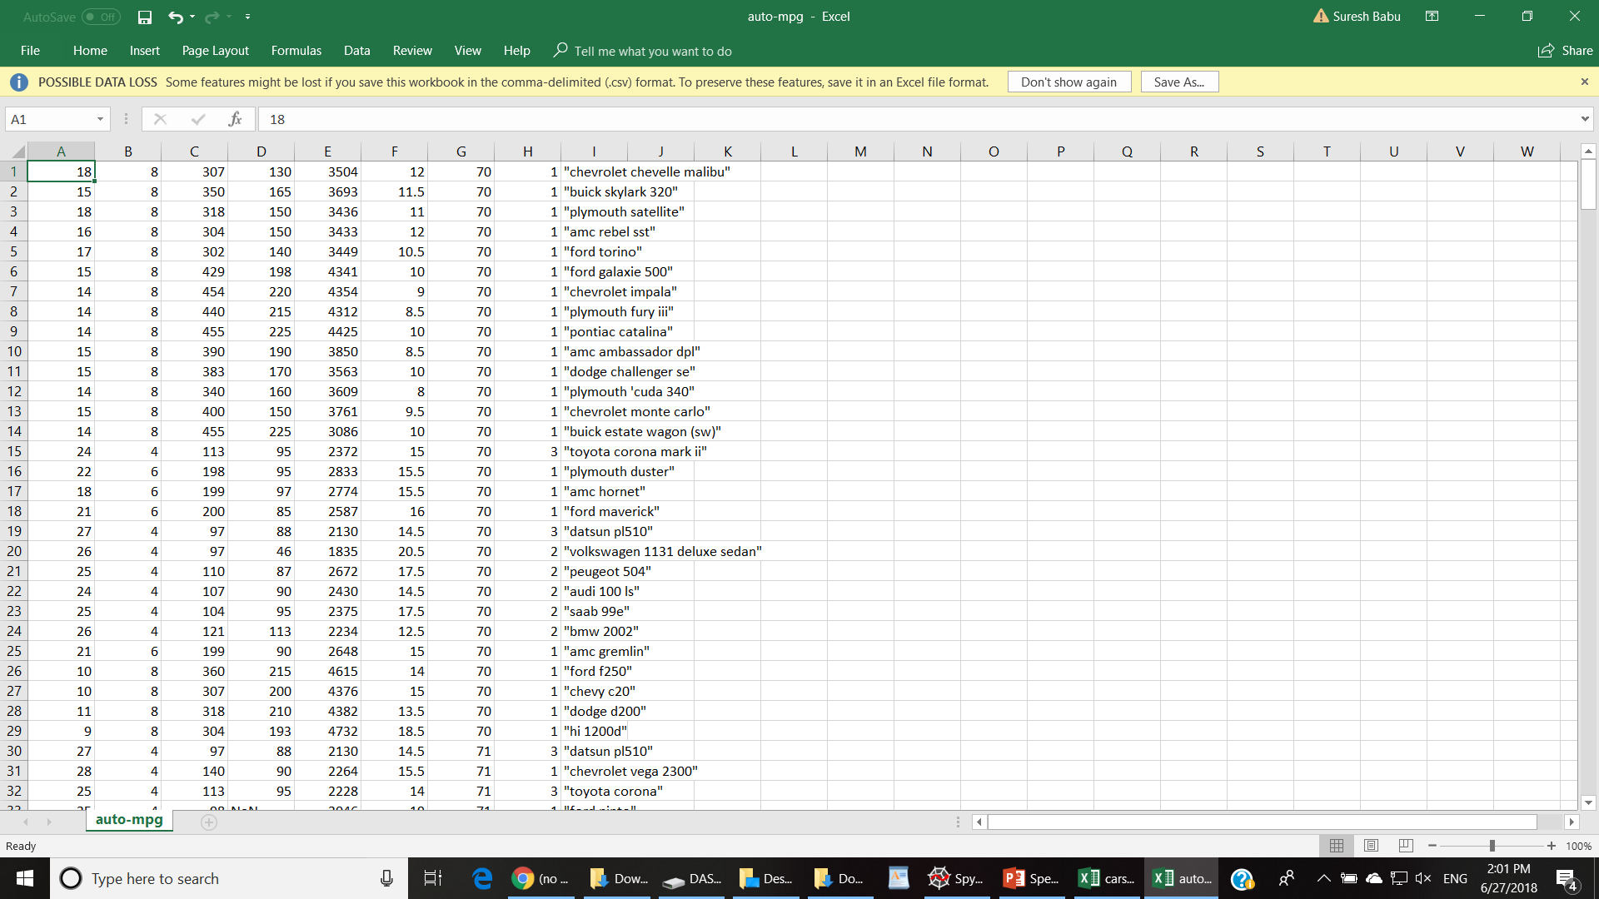
D A T A S E T

Slide 5
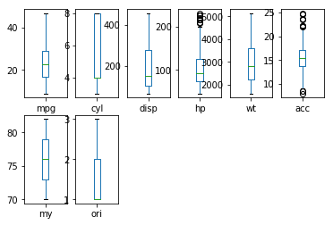
BOX PLOTS

Slide 6
Interpretation of Box Plots
The Box Plot shows the minimum value, maximum value, median, lower quartile, upper quartile, and outliers (if any) for every attribute of the car models
Horsepower and acceleration are the only attributes containing outliers
Most attributes being without outliers are better suited for regression analysis

Slide 7
DATA ANALYSIS – LINEAR REGRESSION
REGRESSION LINE :
Y = -17.2184346 + 0.49337632 (mpg) + 0.01989564 (cyl) -0.01695114 (disp) - 0.00647404 (hp) + 0.08057584 (wt) + 0.75077268 (model year) +1.4261405(origin)
Intercept : -17.2184346
Coefficients : -0.49337632, 0.01989564, -0.01695114,
-0.00647404, 0.08057584, 0.75077268, 1.4261405
Score : 82.148%
An 82% score shows this model is pretty good for prediction.

Slide 8
LINEAR REGRESSION
The linear regression line gives the relationship between every specification of the car and the mileage. This model can be used to predict approximately the mileage of a car given all the other specs of the car model. The line is formed such that the distance from all the available data points to this particular line is the minimum. So this line is the best possible one from any set of lines to represent this group of data.

Slide 9
Description of Error in prediction for Each Row
count 3.920000e+02
mean 3.407705e-15
std 3.297760e+00
min -9.590261e+00
25% -2.156516e+00
50% -1.169410e-01
75% 1.868966e+00
max 1.306043e+01
rms 3.294

Slide 10
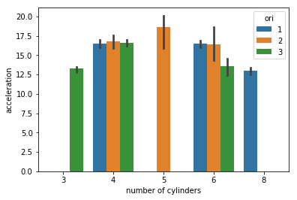
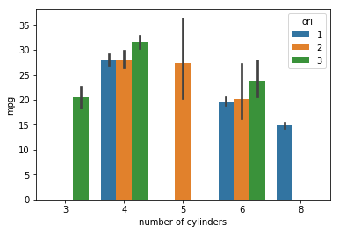
BAR PLOT
ORIGIN
1 –North America
2 – Europe
3 – Asia
<No. of cylinders vs mpg>

Slide 11
INTERPRETATION OF BAR PLOT
Cars with 4 cylinders have the best mileage compared to the others. Among them, Asia has the best mileage.

Slide 12
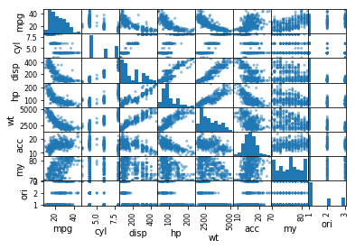
SCATTER MATRIX The scatter matrix gives the relation between every pair of variables in this dataset. It can be used to determine the correlation of any two pairs of independent variables, or between the dependant and any independent variable.

Slide 13
Interpretation of Scatter Matrix
Weight, horsepower, and displacement have a negative correlation with MPG
Origin of the model has no significant correlation with the other features
For any particular number of cylinders, cars can have varying mileages because it has a greater dependency on other factors in comparison with number of cylinders.

Slide 14
CONCLUSION
A model was constructed using Linear Regression to predict the mileage of a particular car model based on its features.
A score of 82.14% was attained for the model made.
A bar graph of mpg vs no. of cylinders was plotted.
Box plots for each car feature were plotted and compared.
The scatter matrix for the features was plotted.

Slide 15
SOURCE
http://archive.ics.uci.edu/ml/datasets/Auto+MPG
We obtained this dataset from the UCI Machine Learning Library

